Slide 1
CSC 422
State space search

Slide 2
Learning content
What is search (a.k.a. state-space search)?
What are these concepts in search?
  Initial state
  Actions / transition model
  State space graph
  Step cost / path cost
  Goal test (cf. goal)
  Solution / optimal solution
What is the difference between expanding a state and generating a state?
What is the frontier (a.k.a. open list)?

Slide 3
Representing actions
The number of actions / operators depends on the representation used in describing a state.
  In the 8-puzzle, we could specify 4 possible moves for each of the 8 tiles, resulting in a total of 4*8=32 operators.
  On the other hand, we could specify four moves for the “blank” square and we would only need 4 operators.
Representational shift can greatly simplify a problem!

Slide 4
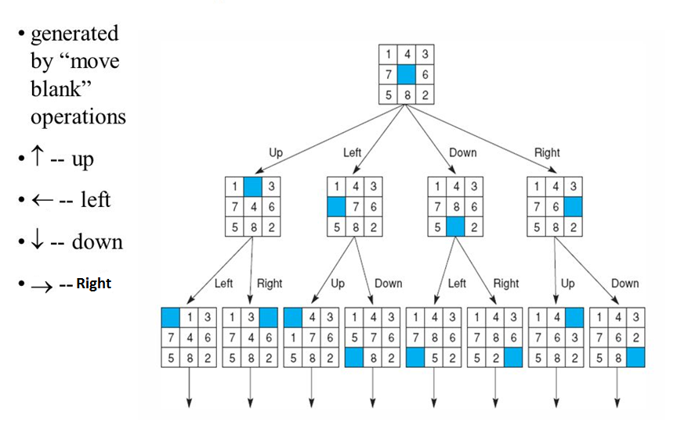

State Space Search - Example

Slide 5
Representing states
What knowledge needs to be represented in a state description to adequately describe the current state or situation of the world?
The size of a problem is usually described in terms of the number of states that are possible.
  Tic-Tac-Toe has about 3⁹ states.
  Checkers has about 10⁴⁰ states.
  Rubik’s Cube has about 10¹⁹ states.
  Chess has about 10¹²⁰ states in a typical game.

Slide 6
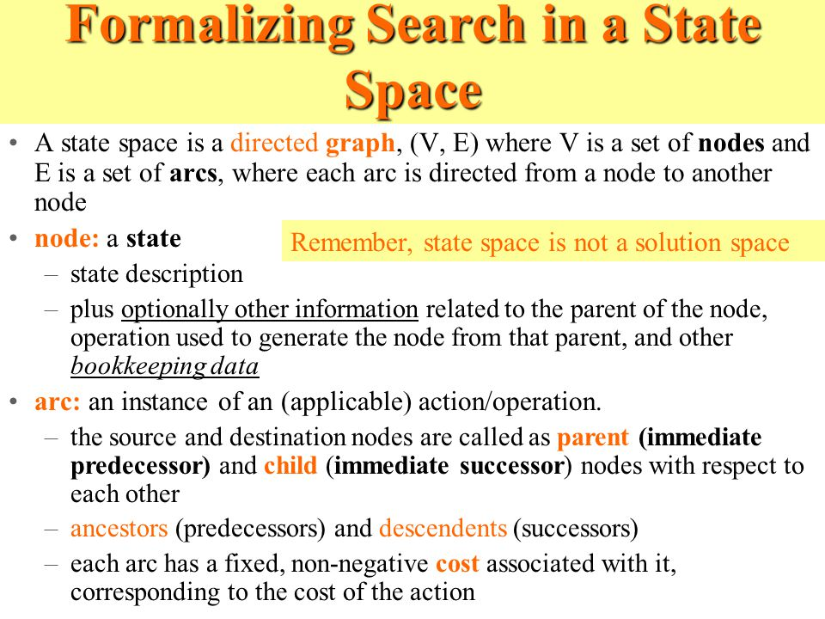

Slide 7
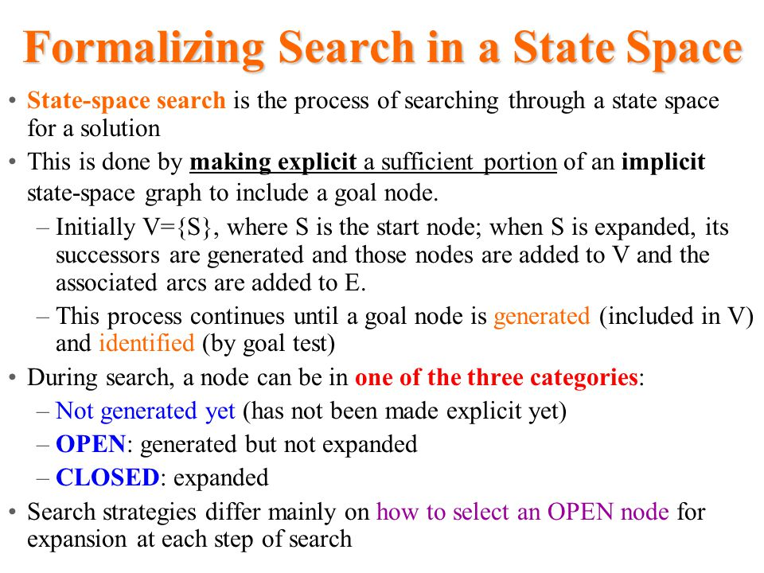

Slide 8
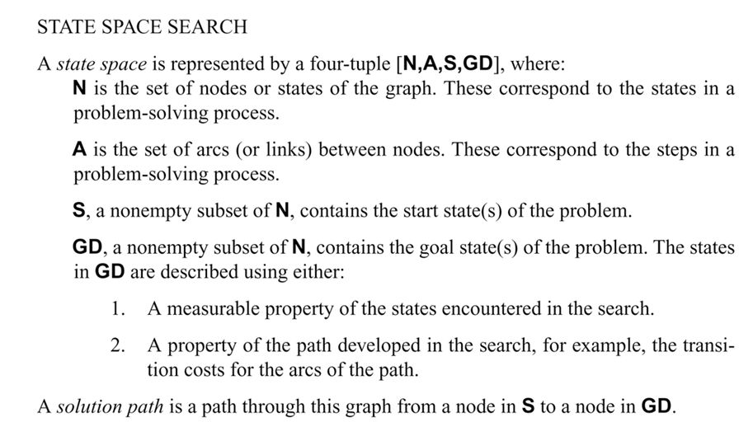
State Space Search Algorithm

Slide 9
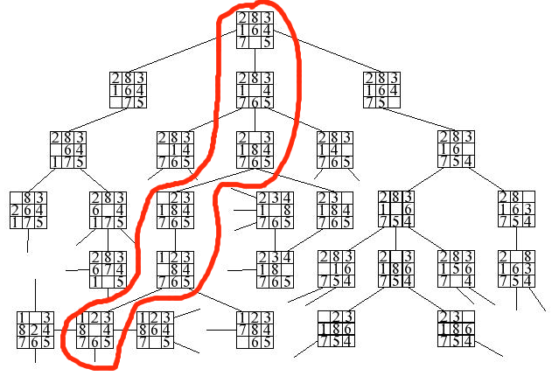
Example of State Space Search Algorithm

Slide 10
Key procedures to be defined
EXPAND -Generate all successor nodes (leaf nodes)
GOAL-TEST - Test if state satisfies all goal conditions
QUEUEING-FUNCTION
  Used to maintain a ranked list of nodes that are candidates for expansion
Typical node data structure includes:
  State at this node
  Parent node (root)
  Depth of this node (number of operator applications since initial state)
  Cost of the path (sum of each operator application so far)

Slide 11
Some issues
Search process constructs a search tree, where
  root is the initial state and
  leaf nodes are nodes
    not yet expanded (i.e., they are in the list “nodes”) or
    having no successors (i.e., they’re “dead ends” because no operators were applicable and yet they are not goals)
Search tree may be infinite because of loops even if state space is small
Return a path or a node depending on problem.
  8-puzzle returns a path
Changing definition of the QUEUEING-FUNCTION leads to different search strategies

Slide 12
Evaluating search strategies
A solution is a sequence of operators that is associated with a path in a state space from a start node to a goal node.
The cost of a solution is the sum of the arc costs on the solution path.
  If all arcs have the same (unit) cost, then the solution cost is just the length of the solution (number of steps / state transitions)

Slide 13
Evaluating search strategies
Completeness
  Guarantees finding a solution whenever one exists
Time complexity
  How long (worst or average case) does it take to find a solution? Usually measured in terms of the number of nodes expanded
Space complexity
  How much space is used by the algorithm? Usually measured in terms of the maximum size of the “nodes” list during the search
Optimality/Admissibility
  If a solution is found, is it guaranteed to be an optimal one? That is, is it the one with minimum cost?

Slide 14
Water Jug Problem
Given a full 5-gallon jug and an empty 2-gallon jug, the goal is to fill the 2-gallon jug with exactly one gallon of water.
State = (x,y), where x is the number of gallons of water in the 5-gallon jug and y is # of gallons in the 2-gallon jug
Initial State = (5,0)
Goal State = (*,1), where * means any amount
Operator table
Name | Cond. | Transition | Effect
Empty5 | – | (x,y)→(0,y) | Empty 5-gal. jug
Empty2 | – | (x,y)→(x,0) | Empty 2-gal. jug
2to5 | x ≤ 3 | (x,2)→(x+2,0) | Pour 2-gal. into 5-gal.
5to2 | x ≥ 2 | (x,0)→(x-2,2) | Pour 5-gal. into 2-gal.
5to2part | y < 2 | (1,y)→(0,y+1) | Pour partial 5-gal. into 2-gal.

Slide 15
Water Jug Problem (cont.)
To solve this we have to make some assumptions not mentioned in the problem. They are
1. We can fill a jug from the pump.
2. we can pour water out of a jug to the ground.
3. We can pour water from one jug to another.
4. There is no measuring device available.
This is one of the solution
0-3
3-0
3-3
4-2
0-2
2-0

Slide 16
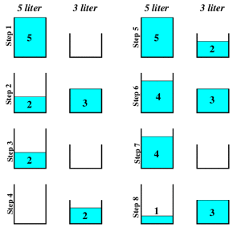
Water Jug Problem (cont.)

Slide 17
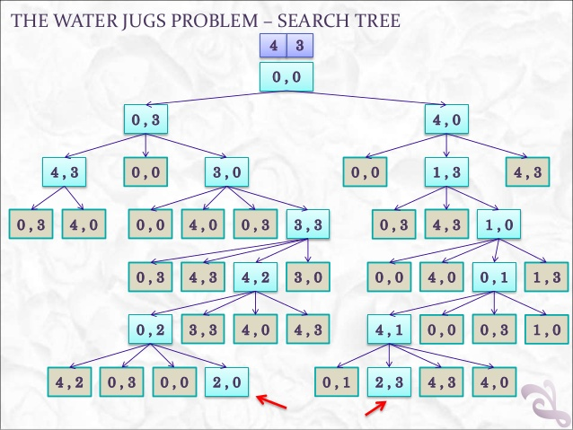
Water Jug Problem - Example

Slide 18
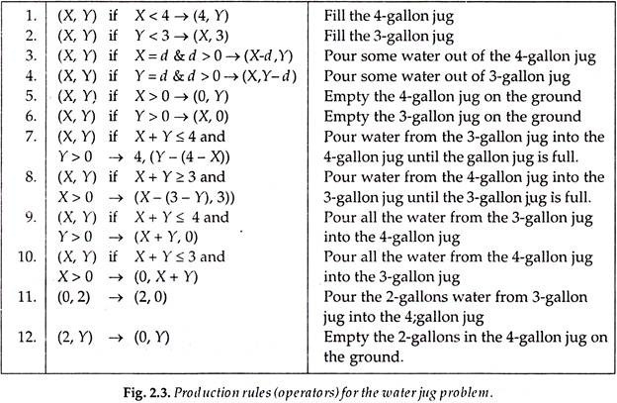
State Rules/Condition

Slide 19
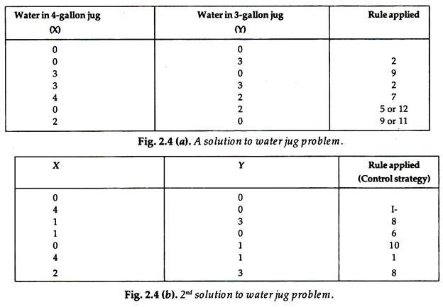
Water Jug Problem - Example

Slide 20
CLASS EXERCISE
Representing a Sudoku puzzle as a search space
  What are the states?
  What are the operators?
  What are the constraints (on operator application)?
  What is the description of the goal state?
Let’s try it!
 | 3
 |  |  | 1
3
 |  | 2

